Slide 1
CS 186 Discussion #4
Heap Files and Buffers

Slide 2
Logistics
Homework 2
Monday, Sept. 28
Finalize partners soon!
Midterm 1
Monday, Oct. 5 (< 2 weeks left!)

Slide 3
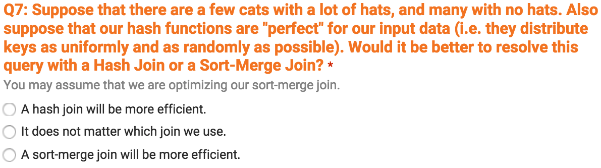

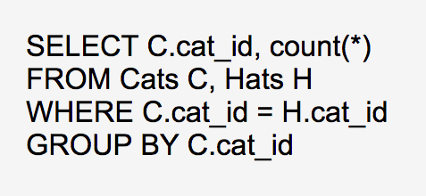

Sort-Merge vs. Hash Joins…

Slide 4
Heap Files
Unordered Files

Slide 5
Heap Files
Within a heap file, keep track of pages
Within a page, keep track of records
Also keep track of free space
RID (Record ID) = <page id, slot #>

Slide 6
Page Directory
Data Page 1
Header Page
Data Page 2
Header Page
Data Page 3
Header Page
Keep # free bytes on page in directory entries

Slide 7
Fixed Length Records
Fixed record length
Consistent field length
F1
F2
F3
F4
F1
F2
F3
F4
…
Keep field type info in system catalog
Free Space
N
Field 1
Field 2
Field 3
Field 4
<- Record
Notes:
What’s a system catalog?

Slide 8
Page Format w/ Fixed-Length Records
Slot 1
Slot 1
Slot 2
Slot 2
…
Free Space
Slot 3
Slot N
…
Free Space
Free Space
Slot M
N
1
…
0
1
1
M
Packed
M
…
3
2
1
Unpacked (Bitmap)
Diagrams by Michelle Nguyen
Notes:
N = number of records (there are more than N slots)
M = number of slots

Slide 9
Variable-Length Records
Delimit fields with special characters
Array of field offsets
Typically preferred choice
F1
$
F2
$
F3
$
F1
F2
F3
Notes:
Delimiters aren’t that great! Special char must not appear in fields, and need to scan through whole row for field

Slide 10
Page Format w/ Variable-Length Records
Rid = (i, N)
Page i
Rid = (i, 2)
Want to be able to move records around!
Rid = (i, 1)
Free space
Pointer to start of free space
30
8
24
N
…
2
1
#
Slots
Slotted Page
Diagram by Michelle Nguyen
Notes:
Can also use slotted page for fixed-length records! -> Might want to sort records, so need to move them around

Slide 11
Slotted Page – Detailed View
Slot directory entries:
(start index, length of record)
Start of free space
# Slots
Slot Directory
4
5
0
4
2
9
0
4
9

Slide 12
Buffers

Slide 13
Buffers
General information:
<frame #, page_id, pin_count, dirty>
Only replace frame if pin_count == 0
Write to disk if dirty bit is on

Slide 14
“Clock” Replacement Policy
Approximation of LRU
Store reference bit instead of last access time for page frames
When pin_count drops to 0,
Flip reference bit on
If clock hand reaches an “on” ref.
Flip reference bit off
If clock hand reaches an “off” ref.
Replace page

Slide 15
Worksheet – Clock Policy
Just read A, B, C, D
A
 | B
 |  | C
 |  |  | D
Now request A

Slide 16
Worksheet – Clock Policy
Just requested A
A |  |  |  | *
 | B
 |  | C
 |  |  | D
Now request F

Slide 17
Worksheet – Clock Policy
Just requested A
A |  |  |  | *
 | B
 |  | C
 |  |  | D
Now request F

Slide 18
Worksheet – Clock Policy
Just requested A
A |  |  |  | *
 | B
 |  | C
 |  |  | D
Now request F

Slide 19
Worksheet – Clock Policy
Just requested A
A |  |  |  | *
 | B
 |  | C
 |  |  | D
Now request F

Slide 20
Worksheet – Clock Policy
Just requested A
A |  |  |  | *
 | B
 |  | C
 |  |  | D
Now request F

Slide 21
Worksheet – Clock Policy
Just requested A
A |  |  |  | *
 | B
 |  | C
 |  |  | D
Now request F

Slide 22
Worksheet – Clock Policy
Just requested F
A |  |  |  | * | F
 | B
 |  | C
 |  |  | D
Now request A

Slide 23
Worksheet – Clock Policy
Just requested F
A |  |  |  | * | F
 | B
 |  | C
 |  |  | D
Now request A

Slide 24
Worksheet – Clock Policy
Just requested A
A |  |  |  | * | F
 | B |  |  |  |  | A
 |  | C
 |  |  | D
Now request D

Slide 25
Worksheet – Clock Policy
Just requested A
A |  |  |  | * | F
 | B |  |  |  |  | A
 |  | C
 |  |  | D |  |  |  | *
Now request D

Slide 26
Worksheet – Clock Policy
Just requested D
A |  |  |  | * | F
 | B |  |  |  |  | A
 |  | C
 |  |  | D |  |  |  | *
Now request G

Slide 27
Worksheet – Clock Policy
Just requested D
A |  |  |  | * | F
 | B |  |  |  |  | A
 |  | C
 |  |  | D |  |  |  | *
Now request G

Slide 28
Worksheet – Clock Policy
Just requested G
A |  |  |  | * | F
 | B |  |  |  |  | A
 |  | C |  |  |  |  |  | G
 |  |  | D |  |  |  | *
Now request D

Slide 29
Worksheet – Clock Policy
Just requested D
A |  |  |  | * | F
 | B |  |  |  |  | A
 |  | C |  |  |  |  |  | G
 |  |  | D |  |  |  | * |  | *
Now request G

Slide 30
Worksheet – Clock Policy
Just requested G
A |  |  |  | * | F
 | B |  |  |  |  | A
 |  | C |  |  |  |  |  | G |  | *
 |  |  | D |  |  |  | * |  | *
Now request E

Slide 31
Worksheet – Clock Policy
Just requested G
A |  |  |  | * | F
 | B |  |  |  |  | A
 |  | C |  |  |  |  |  | G |  | *
 |  |  | D |  |  |  | * |  | *
Now request E

Slide 32
Worksheet – Clock Policy
Just requested E
A |  |  |  | * | F
 | B |  |  |  |  | A
 |  | C |  |  |  |  |  | G |  | *
 |  |  | D |  |  |  | * |  | * |  | E
Now request D

Slide 33
Worksheet – Clock Policy
Just requested D
A |  |  |  | * | F |  |  |  |  |  |  | D
 | B |  |  |  |  | A
 |  | C |  |  |  |  |  | G |  | *
 |  |  | D |  |  |  | * |  | * |  | E
Now request F

Slide 34
Worksheet – Clock Policy
Just requested F
A |  |  |  | * | F |  |  |  |  |  |  | D
 | B |  |  |  |  | A |  |  |  |  |  |  | F
 |  | C |  |  |  |  |  | G |  | *
 |  |  | D |  |  |  | * |  | * |  | E

